Slide 1
Biological Databases

Slide 2
Database
Its central shareable resource.
They are effectively electronic filing cabinets.
They store large amount of information.
Different types of databases- depending on the nature of the information stored.
They can be flat files, tables in a relational database or objects in object oriented databases.

Slide 3
Flat File
In databases a flat file refers to data files that contain records with no structured relationships. Flat files may contain only basic formatting, have a small fixed number of fields, and it may or may not have a file format.
A human readable data-file in a convenient form for interchange of database information.
Created as output from relational databases, in a format suitable for loading into other databases.

Slide 4
Searching Database
Name of Gene/ Protein
Keywords
Accession Number
Organism
Pathways
Population studies
Research papers

Slide 5
Types of Databases
Public domain databases
Entrez, SWISS-PROT
Private domain databases
Yeast Database
RNA Database
Pharmacological Database

Slide 6
Primary Databases
DNA Primary Database
NCBI-GenBank
EMBL
DNA Databank of Japan- DDBJ

Slide 7
NCBI

Slide 8
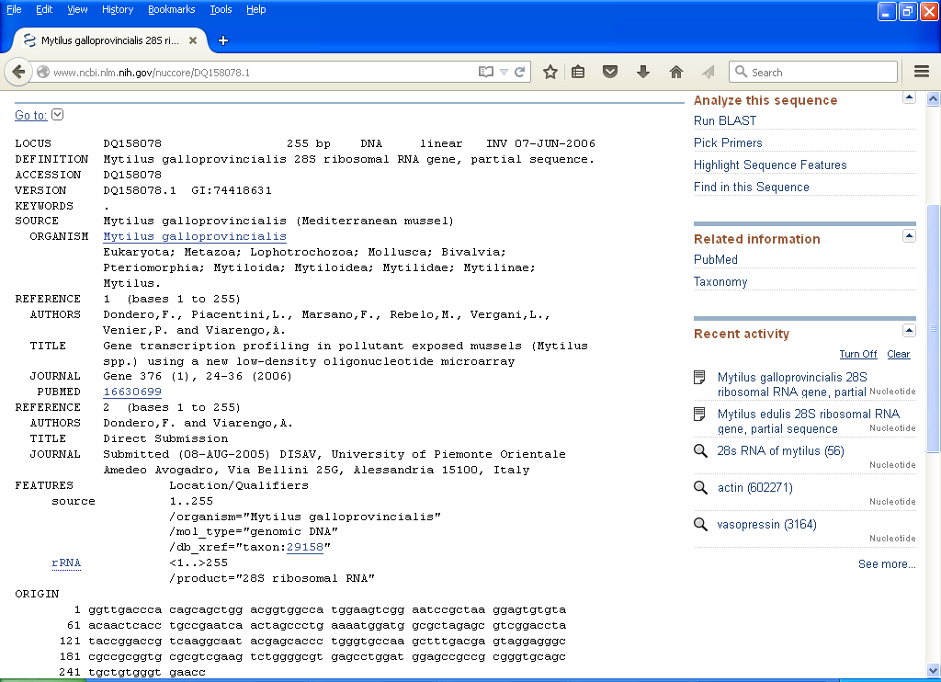

Slide 9
EMBL_EBI

Slide 12
DDBJ

Slide 16
Protein Primary Database
Primary Structure of Protein
Databases
PIR
MIPS
SWISS PROT
TrEMBL
NRL-3D

Slide 17
PIR
Protein Information Resource
Developed by National Biomedical Research Foundation in 1960s.
4 sections
PIR 1 – fully classified and annotated
PIR 2 – primary entries
PIR 3 – Unverified entries
PIR 4 – Conceptual Translation

Slide 18
MIPS
Martinsried Institute of Protein Sequences
Processes sequences for PIR- International Protein Sequence Database Project.

Slide 19
Swiss- Prot
Protein Sequence Database of EMBL-EBI.
Formed in 1986
Changes and collaboration till 1998.
Maintained along with Swiss Institute of Bioinformatics along with EMBL/EBI.

Slide 25
TrEMBL
A computer annotated supplement to SWISS-PROT.
Formed in 1996
Called Translated EMBL
Contains translation of all coding sequences in EMBL.
The database format is same as SWISS-PROT.

Slide 26
NRL-3D
Produced by PIR from sequences extracted from PDB.
Makes sequence information in the PDB available both for keyword interrogation and for similarity search.
Uses multiple database information retrieval system like ATLAS.

Slide 27
Composite Protein Sequence Database
Renders sequence searching much more efficiently.
Complies a composite – merges a variety of different primary sources.
Effort to remove redunancy.
Egs. : NRDB, OWL, MIPSX and SP+TrEMBL

Slide 28
NRDB
Non Redundant Database built by NCBI
Composite of GenPept (GenBank CDS translation), PDB sequences, SWISS-PROT, PIR.
Its non-identical and not non-redundant.
Default database of NCBI BLAST service.
Up to date.

Slide 29
OWL
Built by University of Leeds and Daresbury Laboratory.
Composite of SWISS-PROT, PIR1-4, GenBank and NRL-3D.
Compact and Efficient resource for sequence comparison.
Drawback updates after 6-8 weeks.
Available from EMBnet National Node.

Slide 30
MIPSX
Produced by Max-Planck Institut in Martinsried.
Composite of PIR1-4, MIPS, NRL-3d, SWISS-PROT, translated entries of GenBank and EMBL.
Sequences identical either within or between them are removed.
Subsequences also removed.

Slide 31
SP+TrEMBL
Combination of SWISS-PROT and TrEMBL developed by EBI.
Contains less errors.
Involves data management systems to remove as much as possible redundancy.
Available on EBI web server through SRS.

Slide 32
Thank You

