Slide 1

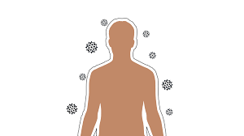


NUTRITION EXERCISE AND HYGIENE TO BOOST IMMUNITY
KRISHNA MISTRY MSc PART 2 LIFE SCIENCES: BIOCHEMISTRY

Slide 2




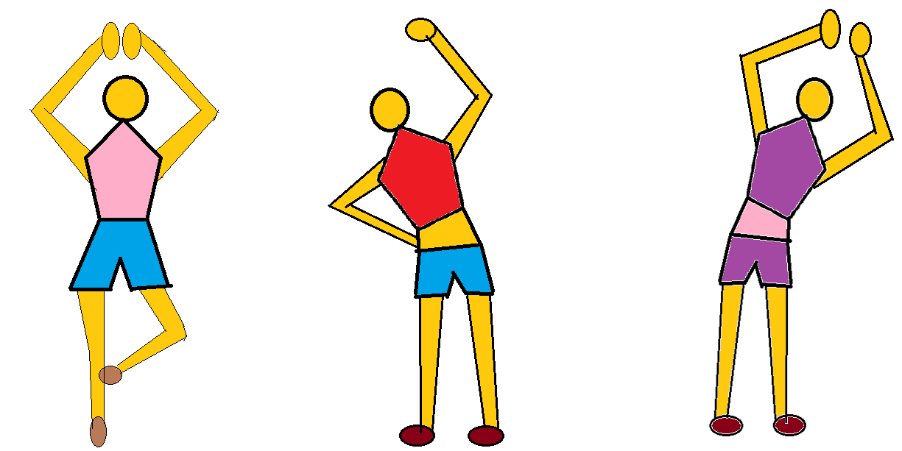


Slide 3

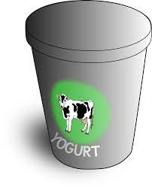




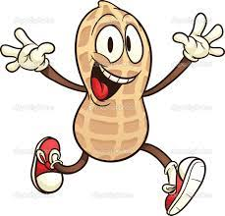
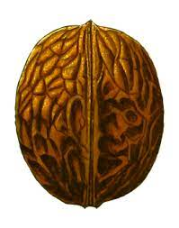


VITAMIN B COMPLEX
VITAMIN A
VITAMIN E
VITAMIN C

Slide 4
