Slide 1
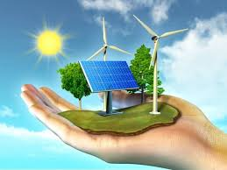
Green Energy
Prepared by
Sanika Parkar
M.Sc. Part-2 (4th Semester)
Department of Life sciences –Aquaculture technology

Slide 2

Solar Power

Slide 3
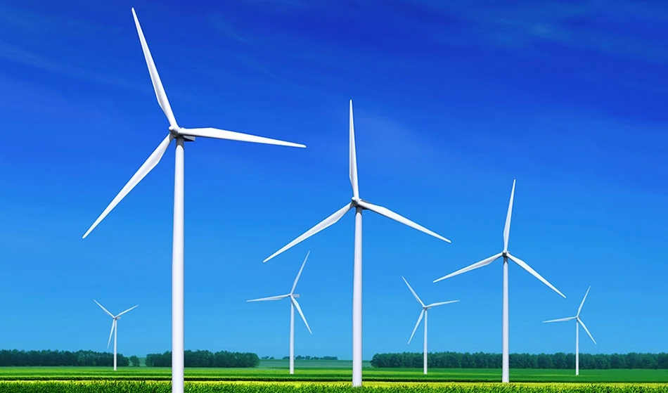
Wind Power

Slide 4
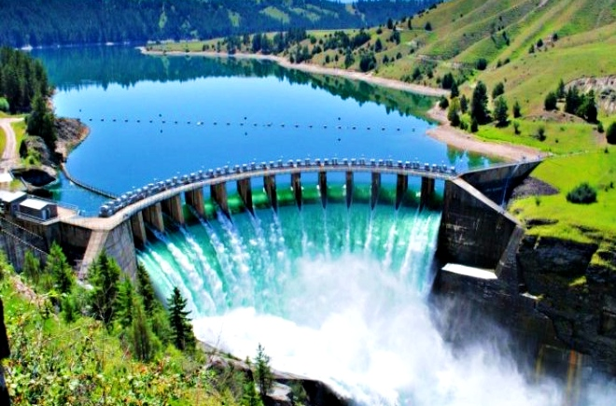
Hydropower

Slide 5
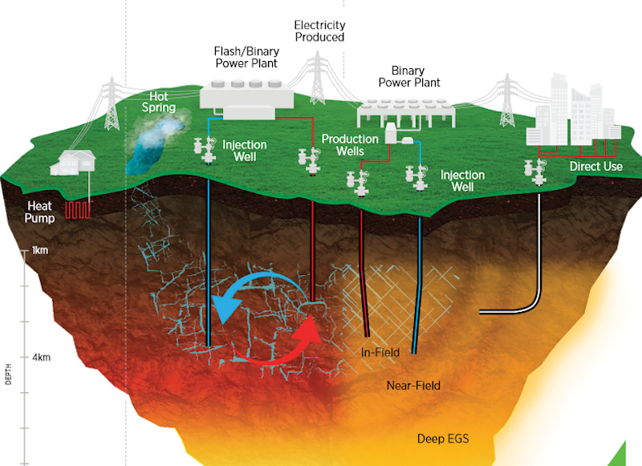
Geothermal Energy

Slide 6
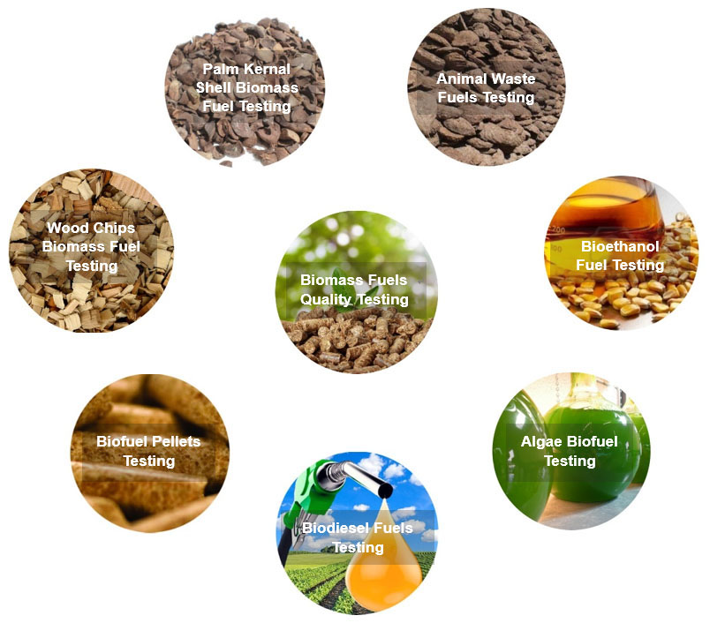
Biomass

Slide 7
Thank you

