Slide 1
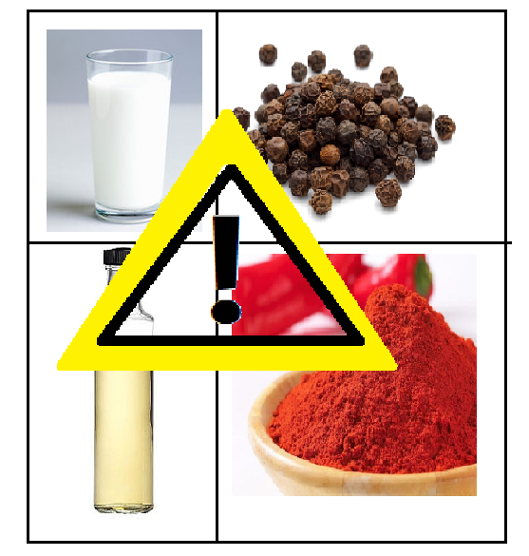
EASY WAYS TO CHECK FOOD ADULTERATION AT HOME
Yashashree neelesh Pradhan msc part 2
DEPARTMENT OF LIFE SCIENCES
SPECILIZATION: BIOCHEMISTRY

Slide 2
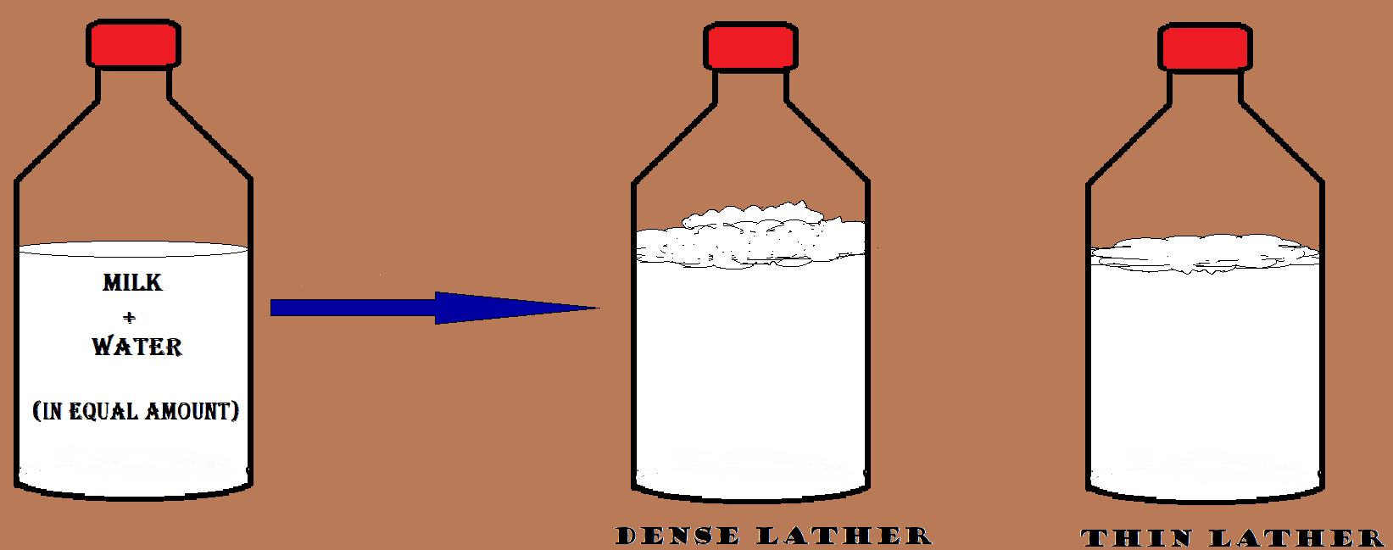
MILK
SAMPLE: MILK ; ADULTERANT: DETERGENT
SHAKE
ADULTERATED
UNADULTERATED

Slide 3
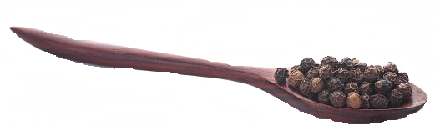
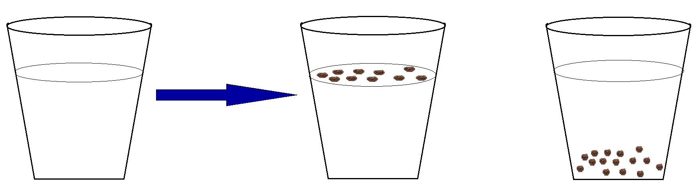
BLACK PEPPER
SAMPLE: BLACK PEPPER ; ADULTERANT: PAPAYA SEEDS
WATER
PAPAYA SEEDS FLOAT
ADULTERATED
BLACK PEPPER SINK
UNADULTERATED

Slide 4
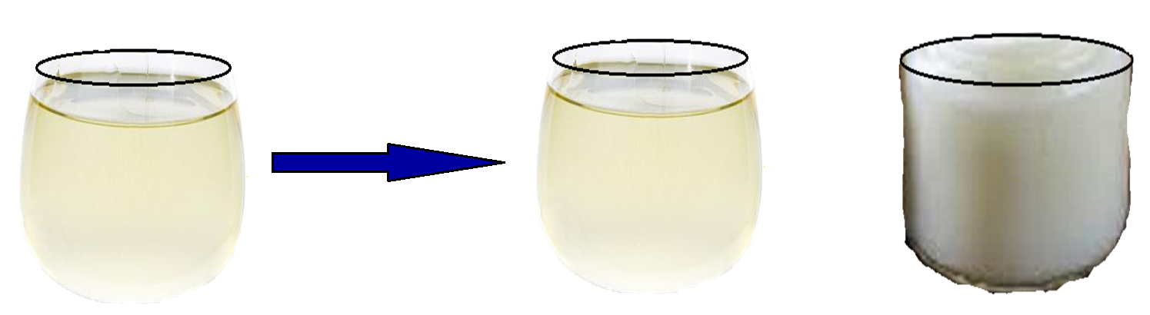
COCONUT OIL
SAMPLE: COCONUT OIL ; ADULTERANT: VEGETABLE OIL
REFRIGERATE
LIQUID
ADULTERATED
FROZEN
UNADULTERATED

Slide 5
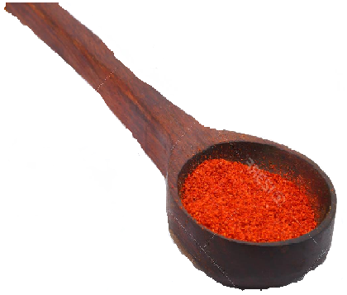
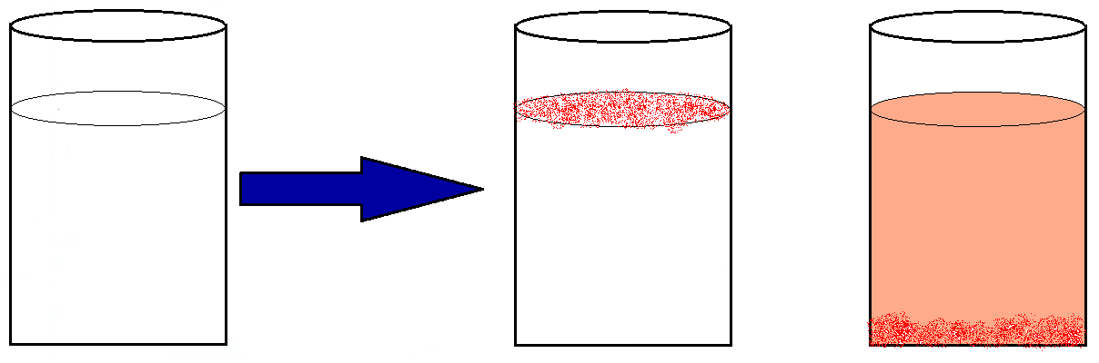
RED CHILLI POWDER
SAMPLE: RED CHILLI POWDER ; ADULTERANT: SAW DUST
WATER
POWDER FLOAT
ADULTERATED
POWDER SINK & WATER BECOME REDDISH
UNADULTERATED

