Slide 1
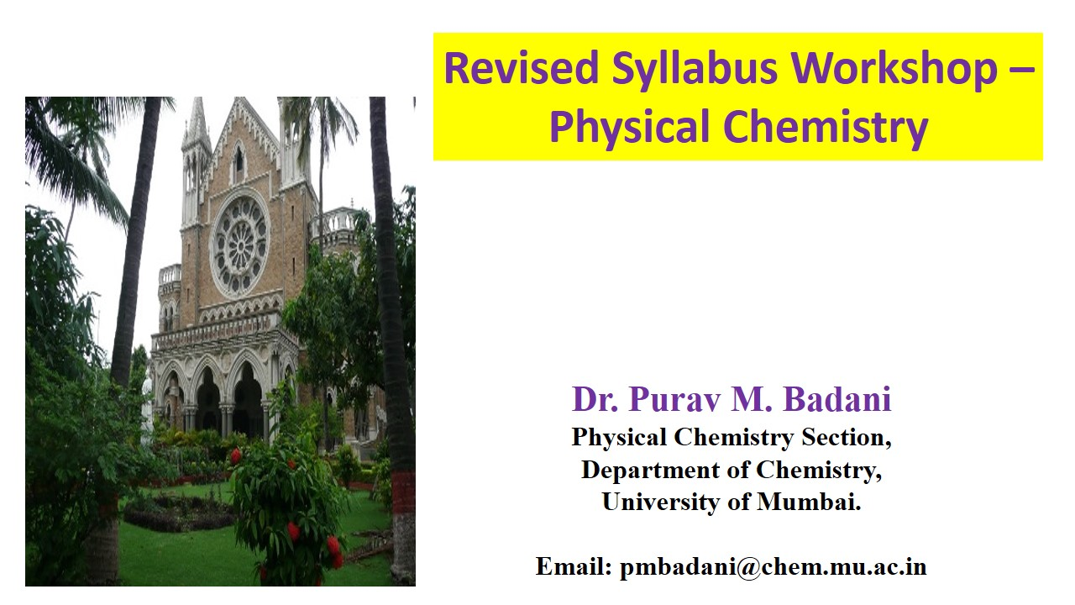
Defects and non-stoichiometry
Course : M.Sc Chemistry
Topic- CHEM : 101 (Unit 2)

Slide 2
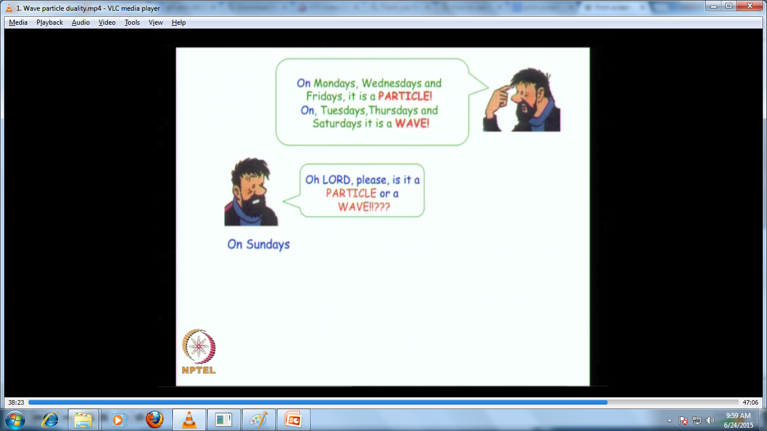
What is Defects in solid?
Crystalline solids are formed by regular repetition of large number of unit cells in all directions.
A perfect crystal has all constituent particles, atoms or ions arranged in a precise geometric order.
All big crystals are found to have some discontinuity in the regularity of arrangement of unit cells.
This discontinuity in arrangement of constituent is known as Defect in Crystal.

Slide 3
Types of Defects
Point Defect
Line Defect
Plane Defect
Schottky defect
Edge dislocation
Grain boundary
Frenkel defect
Screw dislocation
Stacking fault
Impurity Defect
Mixed dislocation
Twin boundary

Slide 4
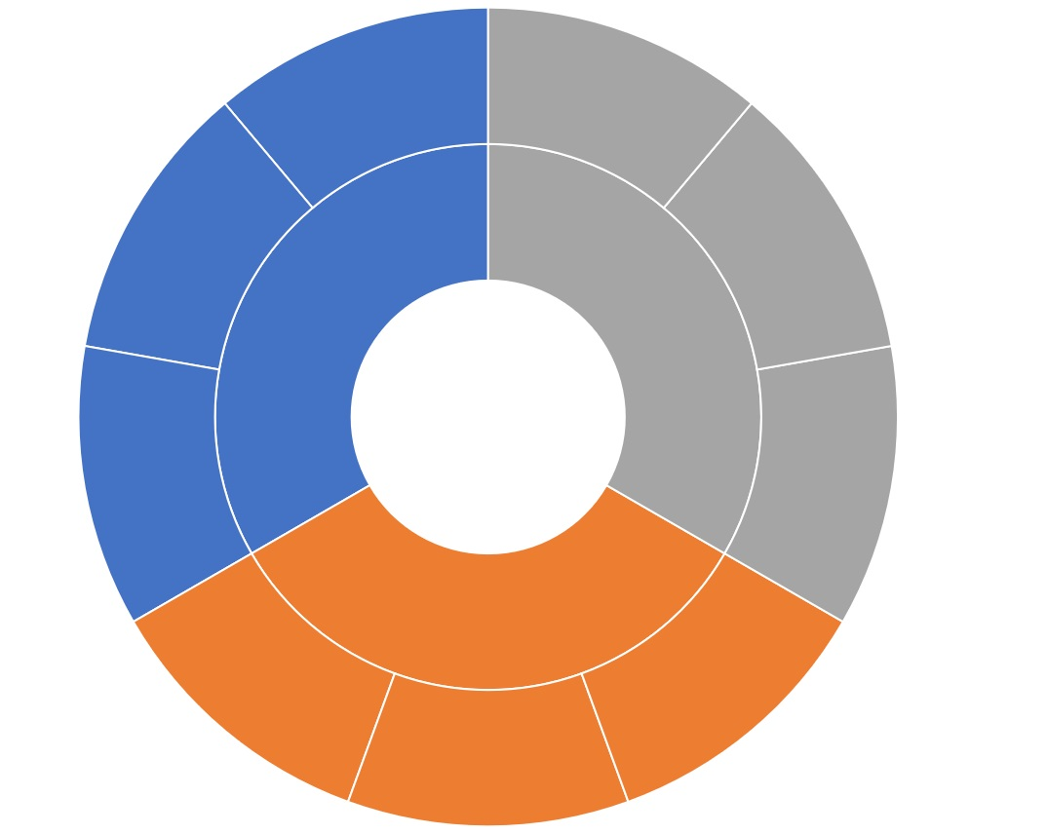
Frenkel
defect
Schottky
defect
Impurity
Defect
Point Defect
Twin
boundary
Types of Defects
Edge
dislocation
Plane Defect
Line Defect
Stacking
fault
Screw
dislocation
Grain
boundary
Mixed
dislocation

Slide 5
Point Defect
Definition: The point defect is defined as the fault produced in the arrangement of a point, i.e. a constituent particle like atom, ion or molecule in a crystalline solid.
Types of Point Defect
Vacancy Defect (Schottky defect)
Example:
NaCl,
KCl,
CsCl.
Interstitial Defect
(Frenkel defect)
Example:
AgCl,
ZnS.
Impurity Defect
Example:
Brass alloy,
Steel Alloy.

Slide 6
Vacancy Defect or Schottky Defect
Definition: The defect produced due to vacancies caused by absence of anions and cations in the crystal lattice is called vacancy defect or Schottky defect.
This was discovered by a German scientist Schottky in 1930.
This defect mainly observed in ionic crystal. Example: NaCl, KCl, KBr etc.
This defect mainly occurs when both cations and anions leave their sites and create two vacancies.
This type of crystal remain electrically neutral.
The presence of Schottky defect in a crystal decrease the density of the crystal.

Slide 7
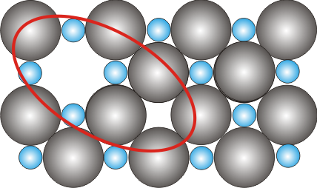
Thermodynamics of Schottky defects
Missing Anion
Missing Cation
The total number of Schottky defects and enthalpy of formation of defect is correlated with each other by following relationship:
Factor ‘2’ ⇒ the increase is steeper with ‘T’ as compared to vacancies
n_{s} → no. of Schottky defects
ΔH_{s} → enthalpy of formation of a Schottky defect

Slide 8
Interstitial Defect or Frenkel Defect
Definition: When cation or anion from ionic solid leaves its regular site and moves to occupy a place between the lattice site called interstitial position, the defect is called interstitial defect or Frenkel defect.
This was discovered by a Russian scientist Frenkel in 1926.
This defect generally observed in case of relatively smaller cations which can fit into the interstitial space and hence produce the defect.
Example: AgCl, ZnS, etc.
The presence of Frankel defect in the crystal does not change the density of the crystal.

Slide 9
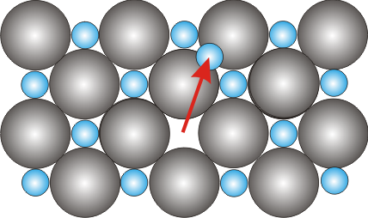
Thermodynamics of Frenkel defects
The total number of Frenkel defects and enthalpy of formation of defect is correlated with each other by following relationship:
n_{F} → no. of Frenkel defects in a MX crystal
ΔH_{F} → enthalpy of formation of a Frenkel defects
N_{i} → no. of interstitial sites available

Slide 10
 | Schottky defect |  | Frankel defect
1. | In an ionic crystal when positive and negative ions are completely missing from their lattice sites and create vacancies in crystal lattice, the defect is called Schottky defect. | 1. | In an ionic crystal, when ion is missing from its lattice position and occupies interstitial position between the lattice points, the defect is called Frenkel defect.
2. | The presence of Schottky defect in a crystal decreases the density of crystal. | 2. | The presence of Frankel defect in the crystal does not change the density of the crystal.
3. | This defect can occurs in ionic crystals having high co-ordination number and the cations and anions have almost same size. i,e, radius ratio r+/r- is almost equal to 1. | 3. | This defect can occurs in ionic crystals having low co-ordination number and cation is smaller in size than the anion. i,e, radius ratio r+/r- is low.
4. | Alkali halides, alkaline earth oxide having NaCl type structure, BeO, TiCl, etc. crystal are examples of ionic compound having Schottky defect. | 4. | Silver halides, ZnS are the examples of ionic compound having Frenkel defect.

Slide 11
Typical enthalpies of formation of Schottky and Frenkel defects.
Schottky Defects
Compound | ΔH_{s} (J) × 10^{–11} | ΔH_{s} (eV)
LiI | 2.08 | 1.30
LiBr | 2.88 | 1.80
NaCl | 3.69 | 2.30
CaO | 9.77 | 6.10
MgO | 10.57 | 6.60
Frenkel Defects
Compound | ΔH_{F} (J) × 10^{–11} | ΔH_{s} (eV)
β-AgI | 1.12 | 0.70
AgBr | 1.92 | 1.20
AgCl | 2.56 | 1.60
CaF₂ | 4.49 | 2.80
ZrO₂ | 6.57 | 4.10

Slide 12
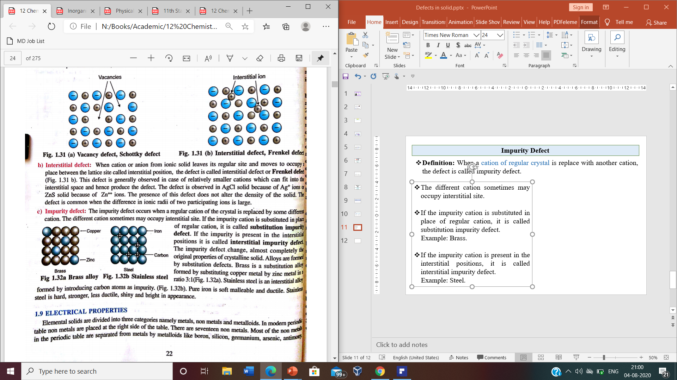
Impurity Defect
Definition: When a cation of regular crystal is replace with another cation, the defect is called impurity defect.
The different cation sometimes may occupy interstitial site.
If the impurity cation is substituted in place of regular cation, it is called substitution impurity defect.
Example: Brass.
If the impurity cation is present in the interstitial positions, it is called interstitial impurity defect.
Example: Steel.

Slide 13
Line Defect
Definition: The line defect is defined as the irregularity in a complete line, a row of lattice points of constituent particles.
Types of Line Defect
Edge dislocation
Screw dislocation
Mixed dislocation

Slide 14
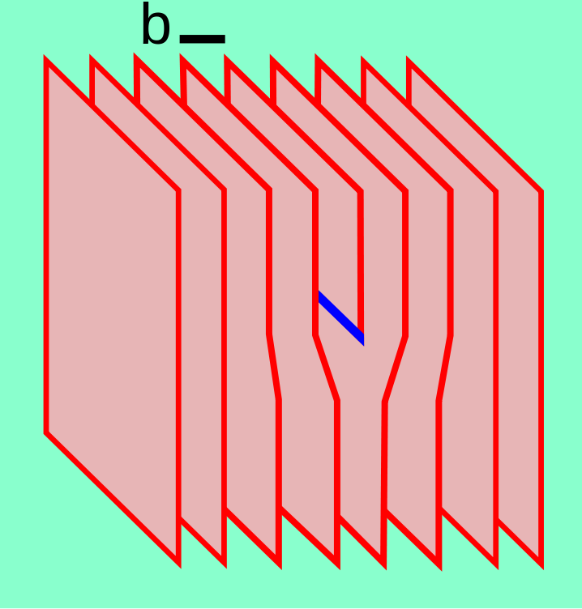
Edge dislocation Defect
Definition: The defects are produced due to the termination of a plane of atoms in the middle of a crystal is called as edge dislocation defect.
Edge dislocation
In such a case, the adjacent planes are not straight, but instead bend around the edge of the terminating plane so that the crystal structure is perfectly ordered on either side.

Slide 15
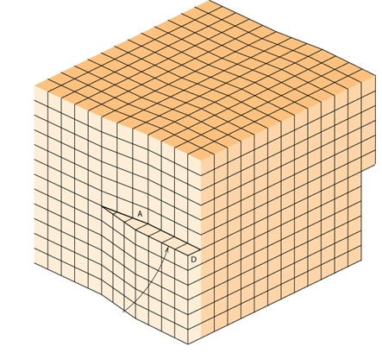
Screw dislocation Defect
Definition: The defects are produced due to the movement of small portion of crystal from their original position, is called as screw dislocation defect.
The screw dislocation is slightly more difficult to visualize.
Edge dislocation

Slide 16
Mixed dislocation Defect
Definition: The defects are produced due to the both termination of a plane and movement of small portion of crystal from their original position, is called as mixed dislocation defect.
Mixed
Edge
Screw

Slide 17
Plane Defect
Definition: The plane defect is defined as the irregular arrangement of planes into the crystal of solid.
Types of Plane Defect
Grain boundary
Stacking fault
Twin boundary

Slide 18
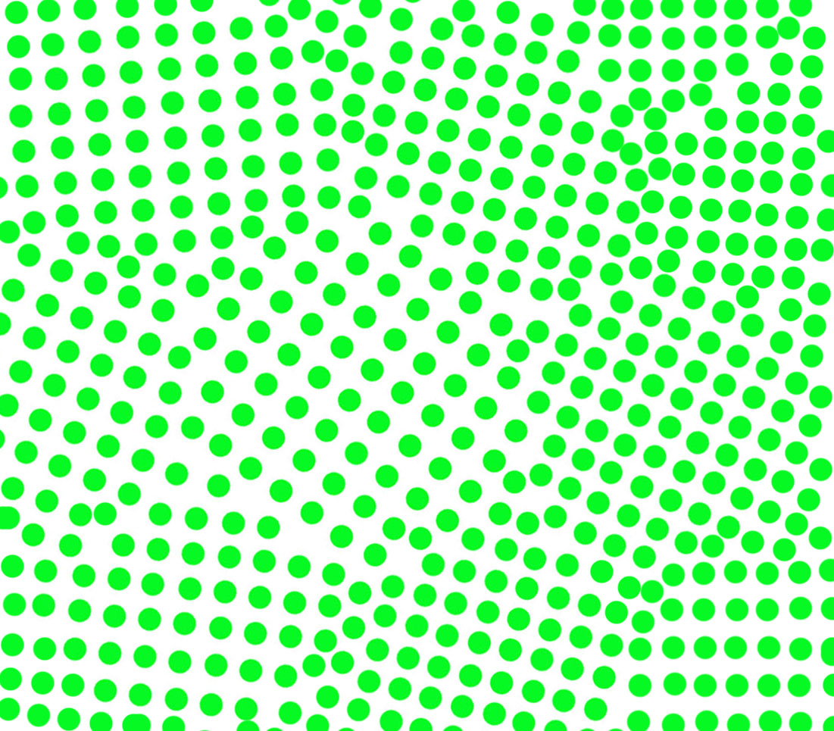
Grain boundaries
Definition: A grain boundary is the interface between two grains, or crystallites, in a polycrystalline material.
Grain boundaries
Grain boundaries are 2D defects in the crystal structure, and tend to decrease the electrical and thermal conductivity of the material.
Most grain boundaries are preferred sites for the onset of corrosion.

Slide 19
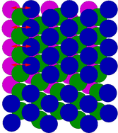
Stacking fault
Definition: A stacking fault is a type of defect which characterizes the disordering of crystallographic planes.
Face-centered cubic (fcc) structures differ from hexagonal close packed (hcp) structures only in stacking order.
The first two layers are identical for hcp and fcc, and labelled AB. If the third layer is placed so that its atoms are directly above those of the first layer, the stacking will be ABA — this is the hcp structure, and it continues ABABABAB.
The another possible location for the third layer, such that its atoms are not above the first layer. Instead, it is the atoms in the fourth layer that are directly above the first layer. This produces the stacking ABCABCABC.
Face centreed cubic crystal
ABC plane
Hexagonal close packed
ABA plane

Slide 20
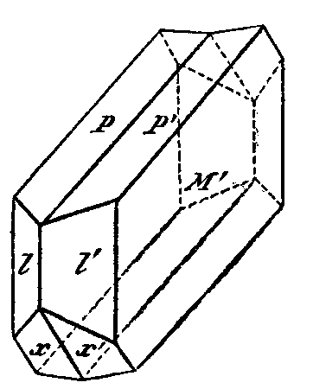
Twin boundary
Definition: Twin boundary occurs when two separate crystals share some of the same crystal lattice points in a symmetrical manner.
Twin boundary
The result is an intergrowth of two separate crystals in a variety of specific configurations.
The surface along which the lattice points are shared in twinned crystals is called a composition surface or twin plane.

Slide 21
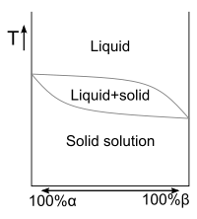
Solid Solution
Definition: When in a solid, the atoms of two or more solute are present in the lattice of the solvent, it is known as solid solution.
The solid solutions are formed, when the two elements (generally metals) involved are close together on the periodic table.
Examples of solid solutions include crystallized salts from their liquid mixture, metal alloys and moist solids.
Solid solutions of semiconductors are of great technological value, as in the combination of gallium arsenide (GaAs) with gallium phosphide (GaP), aluminum arsenide (AlAs), or indium arsenide (InAs).

Slide 22
Types of Solid solution
Substitutional solid solution
Interstitial solid solution
Ordered solid solution
Disordered solid solution

Slide 23
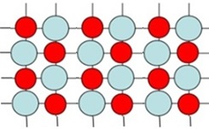
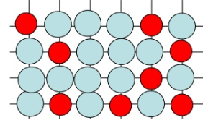
Substitutional Solid Solution
Definition: When the atoms of solute substitute for the atoms of the solvent in its lattice, the solution in known as Substitutional solid solution.
Ordered solid solution.
When the atoms of the solute occupy certain preferred sites in the lattice of the solvent at certain fixed ratios of the solute and solvent atoms, the resulting solution is called as Ordered solid solution.
Disordered solid solution.
When the atoms of the solute occupy certain sites in the lattice of the solvent randomly, the resulting solution is called as Ordered solid solution.

Slide 24
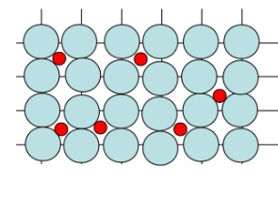
Interstitial Solid Solution
Definition: When the atoms of the solutes occupy the interstitial spaces in the lattice of the solvent, it is known as Interstitial solid solution.
If the size of the solute is less than 40% that of solvent, interstitial solid solution may be formed.
The solute may incorporate into the solvent crystal lattice interstitially, by fitting into the space between solvent particles.
Only Li, Na and B can form interstitial solid solution.

