Slide 1
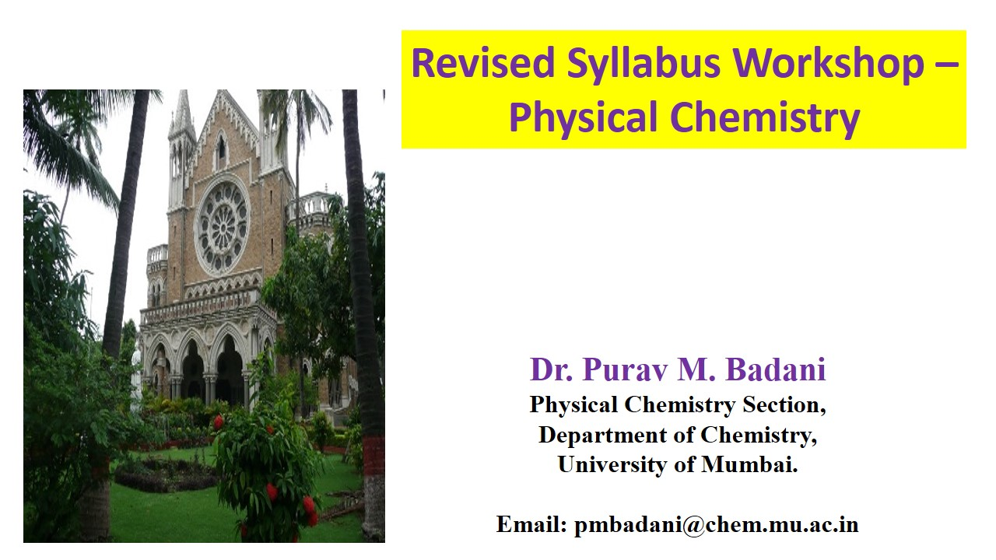
Bonding, structure and preparative methods of solid state compounds
Course : M.Sc Chemistry
Topic- CHEM : 311 (Unit 1)

Slide 2
Classification of solids based on nature of forces:
Ionic solid:
Anion is larger than the cation,
Eg. NaCl, Al₂O₃, Na₂O and ZnO
Anions form the cp layers and the interstitial sites are occupied by cations.
Cations being large at the interstitial sites, the anion array gets expanded.
The anion forms cp arrangement, without being in contact, such an arrangement is termed as eutectic.

Slide 3
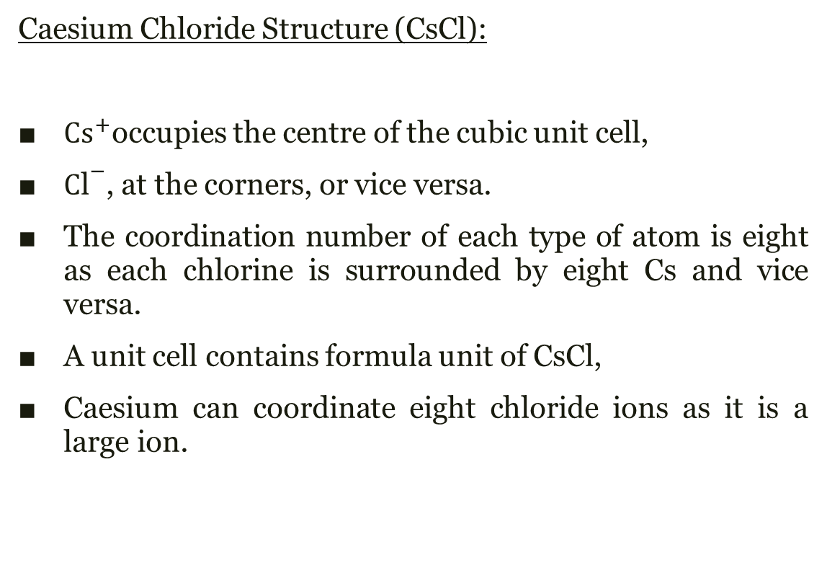
Caesium Chloride Structure (CsCl):
${Cs}^{+}$occupies the centre of the cubic unit cell,
${C\text{l}}^{−}$, at the corners, or vice versa.
The coordination number of each type of atom is eight as each chlorine is surrounded by eight Cs and vice versa.
A unit cell contains formula unit of CsCl,
Caesium can coordinate eight chloride ions as it is a large ion.
The CsCl unit cell.
Cs, grey spheres;
Cl, blue sphere
SOLID STATE CHEMISTRY An Introduction Third ed, 2005

Slide 4
Covalent solid:
Possesses covalent bonds which are strong and directional,
Eg. Diamond, silicon carbide (carborundum)
Diamond is the hardest material due to covalent bonding.
Also known as cp structures or eutactic structures;
Structures resemble ionic compounds.
SiC exhibits wurtzite structure,
Si or C either of them is regarded as the packing atom
The corner-sharing tetrahedra, is the same.

Slide 5
Diamond has a sphalerite structure with half C atoms having ccp array and remaining occupy T+ sites, still both types of atom are equivalent.
Diamond is classified as a eutectic structure.
The atoms have same size and it becomes difficult to distinguish between packing atoms and interstitial atoms.
A unit cell of diamond
SOLID STATE CHEMISTRY An Introduction Third ed, 2005

Slide 6
Metallic solid:
The outermost valence electrons are delocalized in energy bands which cover the entire structure.
This delocalization results in high electrical conductivity.
Most of the elements of s-, d-, f- and p-block elements are metallic.
oxides are metallic in nature.
Eg. superconductors such as YBa₂Cu₃O₇.

Slide 7
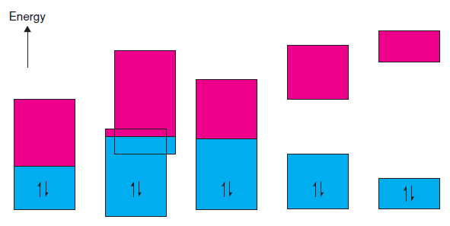
(a)
Na
(b)
Mg
(c)
Graphite
(d)
Si, CdS
(e)
Diamond
The extent of overlap between orbitals and adjacent atoms relates the width of the energy band.
SOLID STATE CHEMISTRY An Introduction Third ed, 2005

Slide 8
The metallic property of Mg is due to the overlap of bands.
If there was no overlap between 3s and 3p bands then Mg would not have been metallic
Its 3s band would be full whereas the 3p band would have been empty and Mg would not be metallic.
This is seen in insulators and semiconductors.
There is Fermi level in Na associated primarily with one partly filled band, the 3s band.

Slide 9
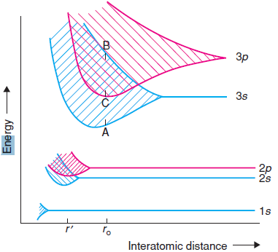
3s and 3p orbitals overlay on nearby atoms
The lower levels of the 3p band and the upper levels of the 3s band in the range C to B possesses similar energies.
Thus there is a continuity between the energy of 3s and 3p bands.
This overlap of bands is the reason for the metallic properties of alkali and alkaline earth metals.
Energy levels and bands for Na
SOLID STATE CHEMISTRY An Introduction Third ed, 2005

Slide 10
Van der Waal bonding:
It is formed between non-polar molecules
It originates mainly due to the following:
1. the spontaneous polarity of molecules such as N₂
2. The prompt variations formed in the charge clouds of the valence electrons.
Van der Waals bonds are weak,
Thus, low melting and boiling points.
The crystal structure of graphite
SOLID STATE CHEMISTRY An Introduction Third ed, 2005

Slide 11
The presence of Van der Waals bonds accounts for the following:
intermolecular interactions.
N₂ can be liquified and solidified at low temperatures.
Gaseous He can be liquified
Eg. covalently bonded layers of carbon atoms in the graphite are held together by these forces.

Slide 12
Hydrogen bonding:
It is formed by the polar interaction between hydrogen and oxygen (or an electronegative element).
Thus these bonds are strong in nature.
Characterised by a partial negative charge, δ⁻, on the electronegative element, and an equal and opposite δ⁺ charge on the hydrogen.
Represented as O–H---O,
the three atoms lie in a straight line
There is alternate strong and weak bond formation.
Eg. Hydrogen bond mostly seen in H₂O and HF.

Slide 13
Crystal structures:
Crystal chemistry blends the basic structural information including the ionic radii, principal oxidation states, the type of bonding and coordination requirements.
The atoms, molecules, or ions form a regular repeating array.
Understanding the crystal structures improves our knowledge regarding the elements and their compounds.

Slide 14
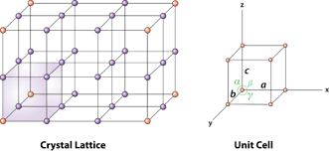
Symmetry and choice of unit cell:
Unit cell:
It is the smallest group of atoms having overall symmetry of a crystal, this on repeating forms a lattice in three dimensions.

Slide 15
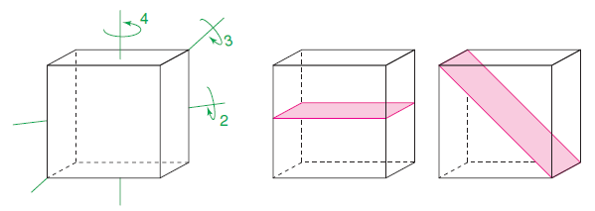
cubic unit cell:
It possesses four threefold symmetry axes, parallel to the cube body diagonals,
a = b = c and α = β = γ = 90◦.
(a)
(b)
(c)
SOLID STATE CHEMISTRY AND ITS APPLICATIONS SECOND ed, STUDENT ed. 2014

Slide 16
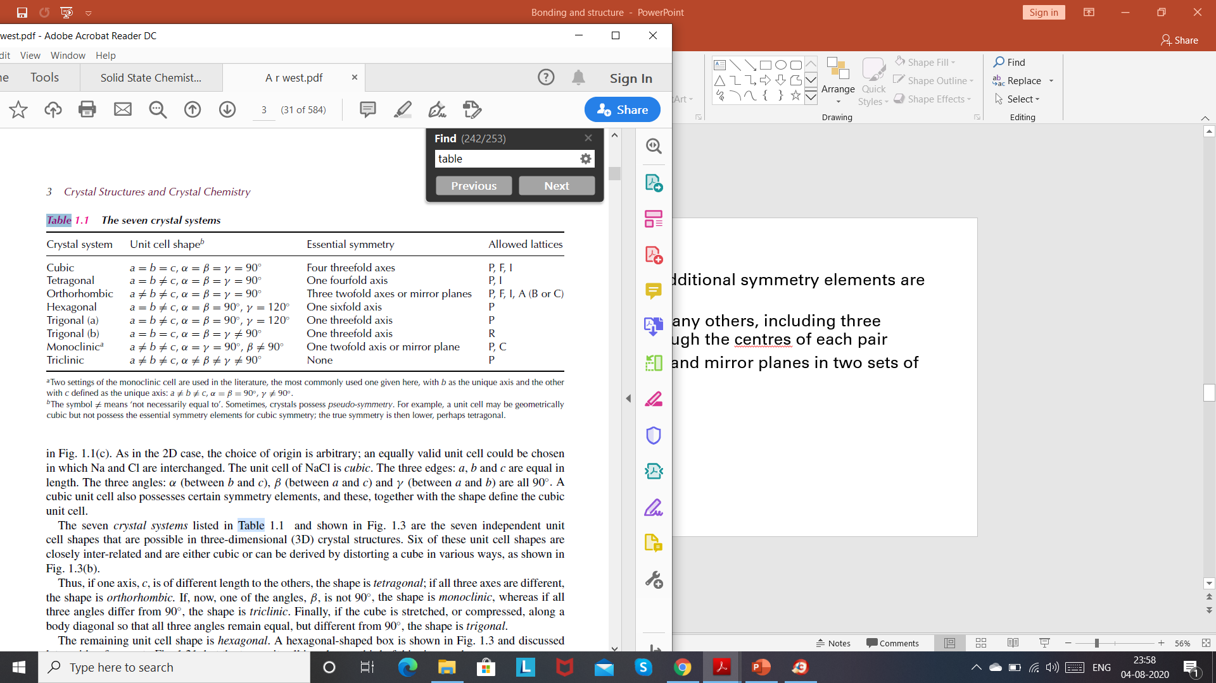
In most crystal systems, the following symmetry elements will be present
The seven crystal systems
SOLID STATE CHEMISTRY AND ITS APPLICATIONS SECOND ed, STUDENT ed. 2014

Slide 17
Tetragonal unit cell:
It possesses a fourfold axis
It does not have threefold rotation axes and two of the fourfold axes.
eg. structure of CaC₂
The carbide ion is cigar-shaped rather than spherical, one of the cell axes becomes longer than the other two
a = b ≠ c and α = β = γ = 90◦.

Slide 18
Trigonal unit cell:
It possesses a three fold axis
eg. structure of NaNO₃
a = b = c and α = β = γ ≠ 90◦.
Hexagonal unit cell:
It possesses a six fold axis
a = b ≠ c and α = β = 90◦, γ = 120◦

Slide 19
Orthorhombic unit cell:
It possesses three twofold axes or mirror plane
eg. structure of NaNO₃
a ≠ b ≠ c and α = β = γ = 90◦.
Monoclinic unit cell:
It possesses a sixfold axis
a = b ≠ c and α = β = 90◦, γ = 120◦
Triclinic unit cell:
It does not possess any symmetry element
a ≠ b ≠ c and α ≠ β ≠ γ ≠ 90◦.

Slide 20
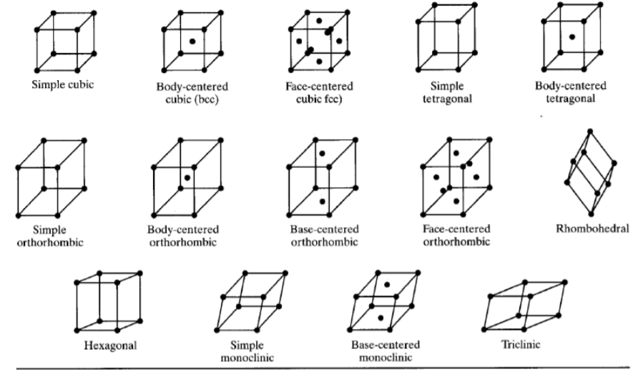
Bravais lattice:
There are fourteen different ways in which the lattice points can be arranged in a three dimensional space.

Slide 21
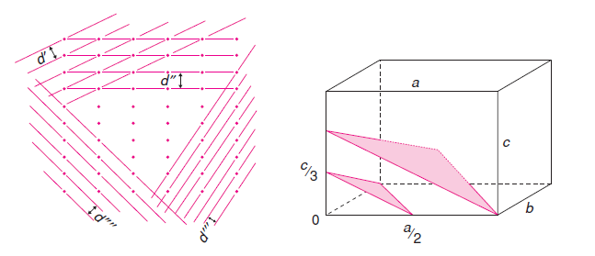
Miller indices:
SOLID STATE CHEMISTRY AND ITS APPLICATIONS SECOND ed, STUDENT ed. 2014

Slide 22
Miller indices :
The three numbers that assign Lattice planes.
Steps to assign Miller indices:
Check the intercept value that the plane cuts at the unit cell. In the figure, the plane makes an intercept at a/2 on x axis, b on y axis and c/3 on z axis. (Weiss indices)
2. Take reciprocals of these fractions and multiply by its least common multiple.
3. write the three numbers in parentheses;
A Miller index of 0 indicates that the plane does not cut the axis and that it is parallel to that axis.

Slide 23
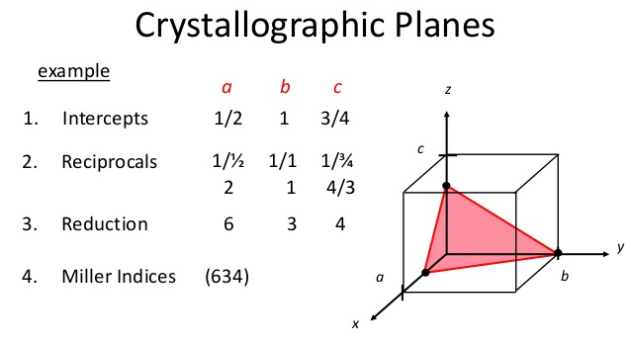
(LCM)

Slide 24
Point groups and Space groups:
Point groups:
It is the set of the symmetry elements of confined objects.
It does not account for the translational symmetry elements
Space groups:
It is the set of the symmetry elements of space with repetitive structures.
It considers even the translational symmetry elements

Slide 25
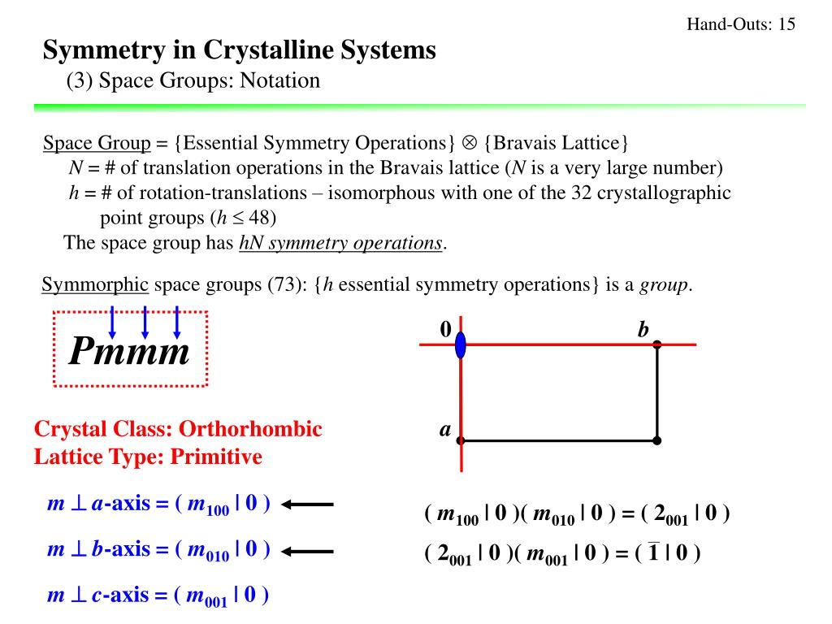

Slide 26
Space Group
14
Bravais Lattices
Add ‘centering’
7
Crystal
Systems
230
Space Groups
32
Point
Groups
Add macroscopic symmetry above minimum
Use microscopic symmetry

Slide 27
Close packing lattices and unit-cells:
Arrangement of spheres so as to increase the packing efficiency.
Each sphere gets surrounded by six spheres.
Thus its coordination number will be 6.
This leads to the formation of a closed pack (cp) layer.
To obtain a 3D structure, the cp layers are stacked over each other.
There are 2 ways of closed packing:
1. Hexagonal close packed
2. Cubic close packed

Slide 28
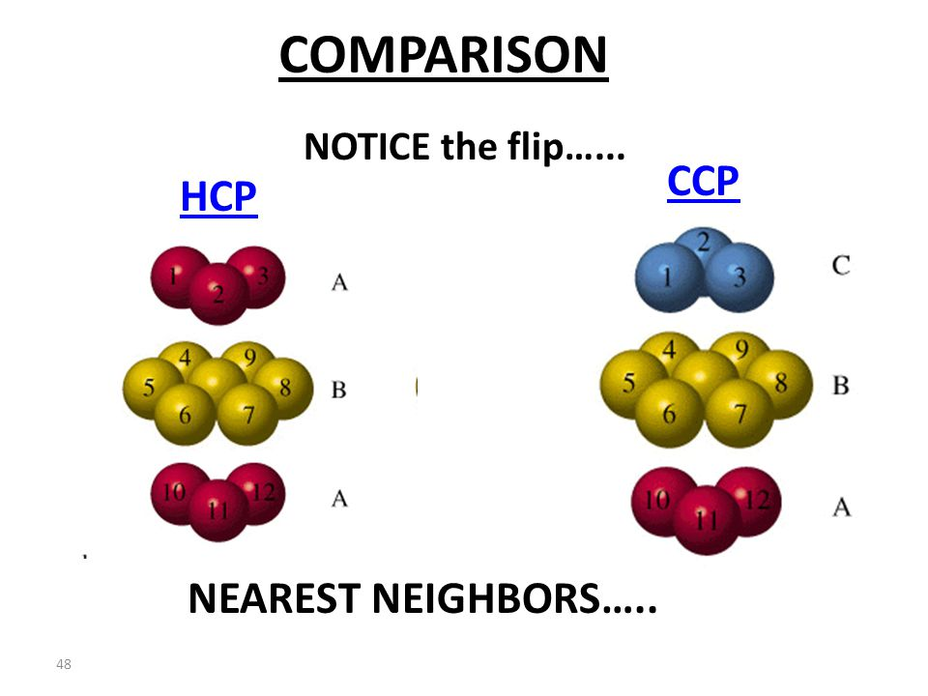

Slide 29
In hcp, the third layer is placed directly over the first layer.
Leads to the formation of ….ABABAB…….
In ccp, the third layer is placed such that all the layers are staggered over each other.
Leads to the formation of ….ABCABCABC…….

Slide 30
Crystalline solids:
Ionic solids with formula MX:
The Caesium Chloride structure (CsCl):
Body centred cubic lattice
Cs : at the centre; Cl at corner,
Coordination number : 8:8
Cs, being large, accommodates eight
chlorine atoms.
Radius ratio : 0.93
CsCl unit cell
SOLID STATE CHEMISTRY An Introduction Third ed, 2005

Slide 31
The Sodium Chloride structure (NaCl):
Rock salt / common salt
Na : at the face centre; Cl at midway of
the edges,
Coordination number : 6:6
Face centred cubic lattice.
Radius ratio : 0.414-0732
Octahedron structure
Eg. AgBr, CsF
NaCl unit cell
SOLID STATE CHEMISTRY An Introduction Third ed, 2005

Slide 32
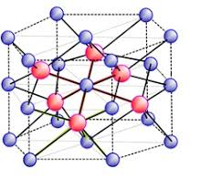
The Nickel Arsenide structure (NiAs):
Hexagonal close packing
Ni : at the octahedral holes
As: centre of trigonal prism formed by six Ni.
Coordination number : 6:6
Face centred cubic lattice.
Radius ratio : 0.414-0732
Octahedral geometry
NiAs unit cell

Slide 33
The Zinc Blende (or Sphalerite) structure:
Sulphur atoms : ccp
Zn atoms : alternate Td voids
Coordination number : 4:4
Radius ratio : 0.41,
Though its radius ratio is0.41,
it forms four co-ordinated.
Very little electronegavity difference
sp³ hybridaisation, which give rise to covalent character
Zinc blende
SOLID STATE CHEMISTRY An Introduction Third ed, 2005

Slide 34
The Wurtzite structure:
Sulphur atoms : hcp
Zn atoms : alternate Td voids
Coordination number : 4:4
Eg. Zno, CdS.BeO
ZnS, Wurtzite
SOLID STATE CHEMISTRY An Introduction Third ed, 2005

Slide 35
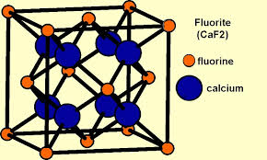
Ionic solids with formula MX₂:
The Fluorite structure:
Ca : ccp
Fluoride ions : Td voids
Coordination number of F : 4
Coordination number of Ca : 8
Fluorite

Slide 36
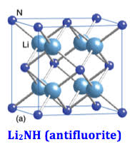
The Antifluorite structure:
Ca : Td voids
Fluoride ions : ccp
Coordination number of F : 8
Coordination number of Ca : 4
Eg. Li₂Te
AntiFluorite

Slide 37
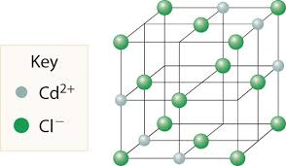
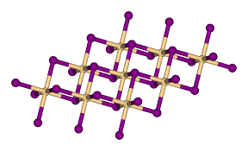
The Cadmium Chloride (CdCl₂) structure:
Cl : ccp
Cd : Oct voids
Co-ordination : 6:3
The Cadmium Iodide (Cdl₂) structure:
I : hcp
Cd : Oct voids
Co-ordination : 6:3
CdI₂

Slide 38
The Rutile (TiO₂)structure:
High refractive index
Scatters the incident visible light
Used as white pigment mostly in paints, plastics
Tetragonal unit cell
coordination no. of Ti : 6
coordination no. of O : 3
Oxygen : corners of a tetrahedron
Ti : corners of equilateral triangle
Rutile, (TiO₂)

Slide 39
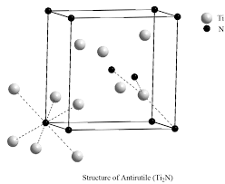
The Antirutile (Ti₂N)structure:
High refractive index
Scatters the incident visible light
Used as white pigment mostly in paints, plastics
Tetragonal unit cell
coordination no. of Ti : 3
coordination no. of N : 6
Ti : corners of a tetrahedron
Oxygen : corners of equilateral triangle
Antirutile, (Ti₂N)

Slide 40
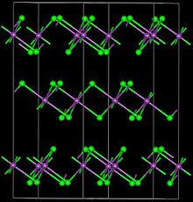
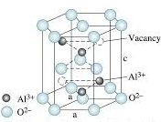
The Bismuth Triiodide (BiI₃)structure:
Iodide : hcp
Bi : 1/3 x (oct voids)
The octahedral sites constitute 2/3rd of the alternate layers.
Corundum Al₂O_{3:}
Contained in ruby, sapphire gemstones
Hard substance
O : cp
Al : occupies 2/3rd of octahedral sites
4 Al surround an O an forms a tetrahedron
Eg. Cr₂O₃, Ti₂O₃
BiI₃
Α-Al₂O₃

Slide 41
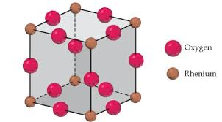
Rhenium Trioxide structure:
Symmetrical 3D network
ReO₆ octahedra linked through each corner
Eg. Fluorides of Rh, Fe, Pd.
ReO₃

Slide 42
Mixed oxide structures:
Spinel:
AB₂O₄
A exists as A²⁺ and B as B³⁺
A²⁺ occupies the Td voids
B³⁺ occupies the Oct voids
Eg. CuAl₂O₄
Inverse Spinel:
A²⁺ occupies the Oct voids
B³⁺ occupies the Td voids
Eg. Fe₃O₄
Spinel AB₂O₄

Slide 43
Perovskite structure:
Named after CaTiO₃
General formula :(ABX₃)
A coordinated to 8 Ti atoms and 12 O
A atoms are positioned at the centre,
B are positioned at the centre,
X at midways of edges
CaTiO₃

Slide 44
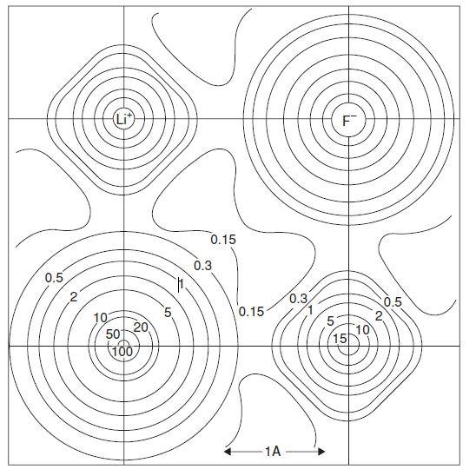
Ionic radii:
It is very basic to have the knowledge of the ionic sizes in the crystal.
Change in the electron density with distance along the line that joins adjacent Li⁺ and F⁻ ions.
SOLID STATE CHEMISTRY An Introduction Third ed, 2005

Slide 45
Trends in ionic radii:
1. The atomic number increases as we move down the group.
As the atomic no. increases, the electrons in it also increase.
Thus the valence electrons are away from the nucleus and ionic radii increases.
2. Isoelectronic cations:
As we move across the period, the nuclear charge increases.
The electrons are pulled by the nucleus and thus ionic radii decreases. (eg. Na⁺ , Mg²⁺)
3. For isoelectronic anions:
The ionic radii increases with the charge, as it’s the anion having higher charge will have low nuclear charge (eg. F⁻, O²⁻).

Slide 46
4. For element with different oxidation states:
The ionic radii of Ti²⁺ > Ti³⁺. The nuclear charge is the same in both cases but the electrons are less in Ti³⁺.
5. The ionic radii across the period decreases. This is because of the electrons getting added in the same shell and the nuclear charge increases as we move across the period.

Slide 47
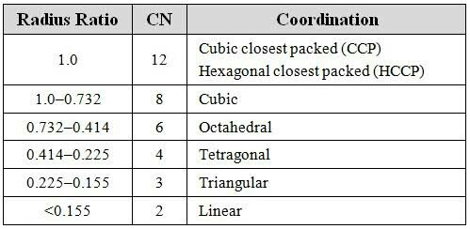

Radius ratio rule:
It is useful in resolving the structure of ionic compounds.
$Radius ratio= \frac{Radius of positive ion}{radius of negative ion}$ = $\frac{r^{+}}{r^{−}}$

Slide 48
Lattice energy:
The lattice energy, U, is the net energy of the arrangement of charges that forms the structure.
NaCl_{(s)} → Na⁺_{(g)} + Cl⁻_{(g),} H = U
The Born-Haber cycle for a metal chloride (MCl)
SOLID STATE CHEMISTRY An Introduction Third ed, 2005

Slide 49
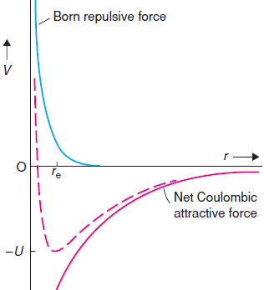
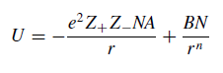
Lattice energy (dashed line) of ionic crystals as a function of internuclear separation.
SOLID STATE CHEMISTRY AND ITS APPLICATIONS SECOND ed, STUDENT ed. 2014

Slide 50
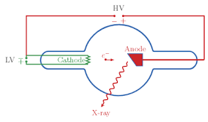
Crystal structure determination by powder diffraction and single crystal X-ray diffraction:
X-ray:
Discovered by German physicist Wilhelm Rontgen (1895).
When electrons activated by an electric field fall on an metal, X-rays get generated.
X-ray bulb

Slide 51
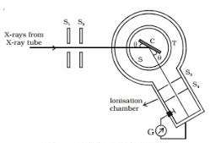
Bragg’s Spectrometer
It consists of source, circular table over which the crystal is kept and the detecting device.
X-rays pass through the slits S₁ and S_{2.}
These rays strike the crystal placed on a movable circular table.

Slide 52
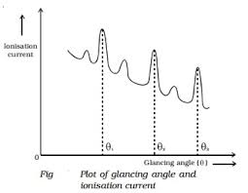
The angular position is examined by the Vernier.
The rays that reflect from crystal fall into the ionisation chamber, filled with SO_{2.}
The reflected X-rays ionise SO₂, according to their intensity.
The intensity of reflection can be measured using an electrometer.

Slide 53
Powder diffraction:
When X-ray is passed through crystalline powder, then diffraction takes place at the angle which satisfies the Bragg condition
nλ = 2dsinθ
Powder diffraction experiment
SOLID STATE CHEMISTRY An Introduction Third ed, 2005

Slide 54
It is presented as a diffractogram
The diffracted intensity, I, is plotted as a function either of the scattering angle 2θ or as a function of the scattering vector length q.
The latter variable has the advantage that the diffractogram is independent of the λ.
Synchrotron sources has widened the choice of wavelength.
To provide comparability of data obtained with different wavelengths, the use of q is therefore preferred.

Slide 55
Solid state reactions
General Principles:
Polycrystalline solids are developed through solid state reactions.
Method of development depends on:
i. Composition of solid
ii. The required form of solid
Eg. a) silica glass
fibre optics laboratory equipment
(Purest form)
b) High pressure is required for synthesis of diamond.
c) Low temperature is desired at the industries so as to save energy.
The starting materials used should be pure.
Assure that the reaction is completed.
Cannot purify a solid after it has been formed.

Slide 56
Preparative Methods:
1. Ceramic Method:
Two non-volatile solids are reacted at high temperature.
Eg. zircon, ZrSiO4, is found useful in ceramic industry. ZrO2(s)+SiO2(s)=ZrSiO4(s) at 1300⁰C
Binary oxides are ground using pestle and mortar until it forms small sized and uniform.
It is placed in alumina crucible and for several hours it is heated in a furnace.
Mixed powders are pelletized in a hydraulic press.
This enhances the number of crystals which face directly to one another.

Slide 57
Re-grounding the powder provides fresh surfaces in contact
Thus it accelerates the rate of reaction.
(a)
(c)
(b)
(c) Furnace
(a) Pestles and mortars
(b) Porcelain, alumina, and platinum crucibles
SOLID STATE CHEMISTRY An Introduction Third ed, 2005

Slide 58
To check the best suitable reaction conditions one needs to perform trial and error.
Electric arc provides higher temperatures up to 3300 K.
Carbon dioxide laser provides temperatures up to 4300 K.
Commonly used crucibles that withstand high temperatures and are inert:
i) silica (is used up to 1430 K),
ii) alumina (is used up to 2200 K),
iii) magnesia (is used up to 2700 K),
Graphite, Pt, Ta linings are also used
For volatile or sensitive reactant, a sealed tube method is used.

Slide 59
This method is used to obtain aluminosilicates, nitrates, sulphides, oxides (spinels), etc.
Disadvantages:
Requires high temperature
Rate of reaction is low
Non-homogeneous product
Separation of product and reactant is difficult as both are in the same phase.

Slide 60
Precursor method:
Mixes at the atomic level.
Metal oxides and carboxylates form the precursors.
It decomposes when heated, which then yields the required product.
Barium titanate, BaTiO₃ of grain size are required in capacitors, this is achieved through this method.
This method enables us to prepare inorganic materials like spinels.
1000⁰C
Fe₂{(COO)₂} ₃ + Zn(COO)₂ ZnFe₂O₄ + 4CO + 4CO₂

Slide 61
Advantages:
Reactants are mixed homogeneously
Low temperature
An increased rate of reaction
Disdvantage:
Difficult to find the required precursor

Slide 62
Sol-Gel Method:
The concentrated solution of reactants is formed, the ‘sol’.
It is further concentrated to form the ‘gel’ by dehydrating it.
The gel is treated (heated) to form the product.
Advantages:
the time required is less
Requires low temperature as compared to direct ceramic method
Material can be synthesized in a specific form.
Steps involve in Sol-gel method
SOLID STATE CHEMISTRY An Introduction Third ed, 2005

Slide 63
Disadvantages:
Cost is high
Limits to compounds capable of forming gel.
Sometimes it results in unwanted products.
Example:
1.Silica glasses:
Optical fibres make use of highly pure transition metal.
The sol-gel process is suitable to make such glasses.
Fractional distillation provides us pure silicon.
(Si(OR)₄), is hydrolysed
Si(OMe)₄+4H₂O=Si(OH)₄+4MeOH
Si(OH)₄ undergoes condensation, pertaining Si—O—Si bonds.

Slide 64
The condensation leads to the formation of sol
It then forms a gel through cross-linking
Surfactants reduce cracking of gels with larger cross section
Density of the glass is increased by heating silica to1300 K
SOLID STATE CHEMISTRY An Introduction Third ed, 2005

Slide 65
MICROWAVE SYNTHESIS:
Used to form mixed oxides.
Any one reactant should be microwave active.
It provides for a controlled reaction.
The charged particles in solids and liquids migrate due to the influence of the field thus, causing current generation.
Heat energy is released as a cause of resistance to their movement.
This is conduction heating.

Slide 66
If the molecule has dipole moment, it gets aligned by the electric field.
This effect results into dielectric heating and this when interacts with water molecules, heats the food in the oven.
Advantages:
There is no loss of heat in Microwave heating
Provides efficient heating
Example:
Synthesis of Superconductor YBa₂Cu₃O₇

Slide 67
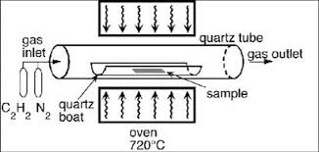
CHEMICAL VAPOR DEPOSITION/
Vapour Phase Epitaxial (VPE) Growth:
Volatile reactants are passed to a furnace
Precursor in the gas phase gets decomposed
The reaction takes place in vapor state.
A single crystal layer gets deposited over the substrate
Example:
2Ga_{(g)}+2AsCl_{3(g)} = 2GaAs_{(s)}+3Cl_{2(g)}
SOLID STATE CHEMISTRY An Introduction Third ed, 2005

Slide 68
CHEMICAL VAPOUR TRANSPORT:
Reaction between the volatile compound and a solid.
Used to preparing and grow crystals from powders.
Example:
Fe₃O₄(s)+8HCl(g)=FeCl₂(g)+2FeCl₃(g)+4H₂O(g)
Magnetite at one end of the sealed tube gets transported down by HCl
Endothermic reaction

Slide 69
Magnetite reacts with HCl and forms FeCl₃ on the right end which is hot
Magnetite gets deposited on the cooler left side.
Growth of magnetite crystals using chemical vapour transport
SOLID STATE CHEMISTRY An Introduction Third ed, 2005

Slide 70
Melt Methods:
Exhibited by compound, showing stability in liquid phase.
The reaction requires high temperature.
It requires inert reaction vessels.

Slide 71
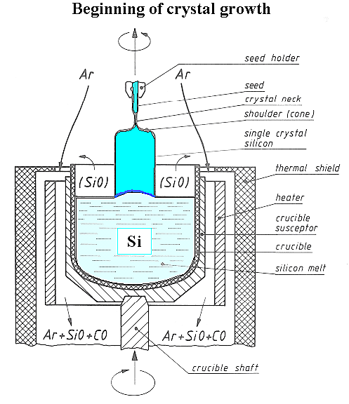
Czochralski Process:
SOLID STATE CHEMISTRY An Introduction Third ed, 2005

Slide 72
Industrial uses of Si requires high purity.
Impurities of phosphorus and boron, are permissible for <1 atom in 10¹⁰ Si.
Silicon is melted in the presence of argon.
Single-crystal rod (acting as a seed) is lowered into the melt which is pulled out at a slow pace.
It brings forth elongated single crystal in the same direction as the original.
It is also used for ceramicuch as perovskites.

Slide 73
Crystallization of Solutions:
Techniques to induce crystallization:
Solvent evaporation done by:
i) heating
ii) freezing the solvent
solid oxides are insoluble in water
They are solubilized in melts of borates, fluorides.
Solvent is known as a flux, which lowers its melting temperature.
The melt cools and forms crystals
used to form crystalline silicates, quartz, and alumina.

Slide 74
High pressure and hydrothermal methods:
Reactants heated in a closed vessel – autoclave, with water.
Autoclave:
a)In order to tolerate high pressure, it is made of
a thick stainless steal, with safety valves.
b)Lined by Teflon – inert material
Super heated water gets generated as the pressure increases above the atmospheric pressure in the autoclave
The temperature is above the boiling temperature.
Such conditions are known as hydrothermal conditions.

Slide 75
The conditions are higher than normal but lower than the conditions required in ceramic and sol-gel.
Advantages:
If oxides insoluble in water at normal pressure then hydrothermal set up can be used in such cases.
If condition requirement is still more, then we can achieve solubility by adding alkali salts which form a soluble complex with the solid.

Slide 76
Magnetoresistance:
When the sample is placed in a magnetic field, we can observe a change in the electric current which passes through the material.
giant magnetoresistance (GMR) : The drop of resistivity to half its zero field value, when the magnetic field of strength of 1 to 3 mT was applied to metallic multilayer materials.
observed in metallic magnetic multilayers.
All the spins are aligned in a single ferromagnetic layer,

Slide 77
The coupling between adjoint ferromagnetic layers depends on the thickness of the non-magnetic layer.
The adjacent ferromagnetic layers couple antiferromagnetically for certain thicknesses,
this increases the resistivity.
When a magnetic field is applied, the layers align in a ferromagnetic manner.
Thus results a significant drop in electrical resistance.

Slide 78
In ferromagnetic materials, most of the electrons possess the same spin state and these electrons will carry most of the current.
We see distinguished energy bands for both spin up and spin down electrons.
Assume one ferromagnetic layer to possess spin up electrons as majority.
Next layer also has a maximum of spin up electrons
Then current flows readily from one ferromagnetic layer to the next.

Slide 79
Two magnetic layers separated by a nonmagnetic layer with
(a) the spins aligned ferromagnetically
(b) the spins aligned antiferromagnetically
SOLID STATE CHEMISTRY An Introduction Third ed, 2005

Slide 80
Zeolites:
crystalline aluminosilicates
It has an anionic framework with cavities containing exchangeable metal cations.
Primary building units [SiO₄]₄− and [AlO₄]₅− tetrahedra
They are lined by corner sharing.
an electrical imbalance is formed when Al(III) replaces Si(IV)
each [AlO₄] tetrahedron is balanced by positive charge made available by the exchangeable cations within the zeolite.

Slide 81
Zeolites are formed naturally by hydrothermal methods.
The synthesis of zeolite:
Alkali, aluminium hydroxide and silica are mixed followed by condensing into a gel
It is heated at 373K
Zeolites crystallize out in place of other aluminosilicate phases.
Eg. (Na₁₂[(AlO₂)₁₂(SiO₂)₁₂].27H₂O) hydrated alumina, Al₂O₃.3H₂O, is solubilised in concentrated sodium hydroxide solution.
The solution is cooled and then mixed with a solution of sodium metasilicate, Na₂SiO₃.9H₂O, which forms heavy white gel.
Further, it is placed in Teflon bottle and kept under Microwave radiation (45 minutes).

Slide 82
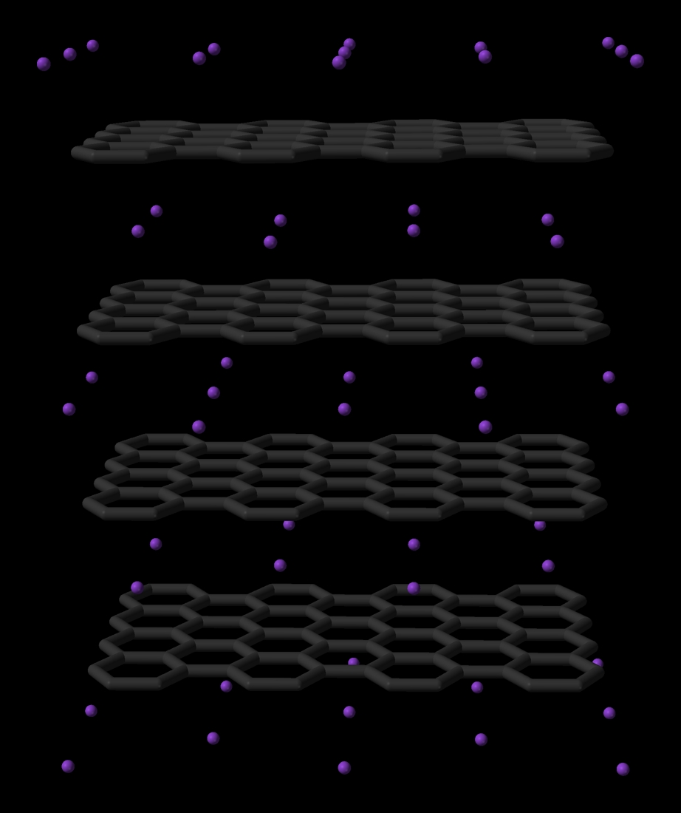
Intercalation compounds:
Reversible insertion of guest molecules into lattices leads to the formation of intercalation compounds.
Applied to layered solids and those with similar host-guest interactions.
Used as:
i)Catalysts
ii) electrode materials
iii) probe in drug delivery systems

Slide 83
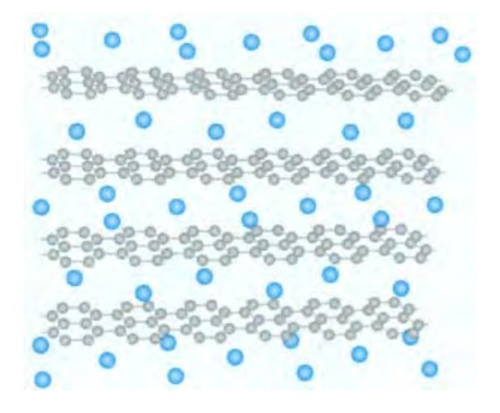
Graphite Intercalation Compounds
A molecule which is neutral, is inserted between weakly bonded carbon layers.
Eg; K (vapour or melt ) + Graphite KC₈
Potassium gives an electron to the graphite (forming K⁺) and the conductivity of the graphite increases.
The interlayer spacing increases since K⁺ ions are found between the graphite layers.
NO₃⁻, CrO₃, Br_{2,} , FeCl₃, and AsF₅ are also used to form graphite electron-acceptor intercalation compounds.
(Above 337 K)
The structure of KC8.
K, blue; C, grey
SOLID STATE CHEMISTRY An Introduction Third ed, 2005

Slide 84
Transition Metal Dichalcogenides
One can even find layered structures for transition metal oxides and sulfides
It intercalates with group I metals (Li, Na, K) resulting into superconducting solid state battery materials.
The conductivity of titanium disulfide increases when it forms intercalation compounds with electron donors.
Eg; lithium, Li_{x}TiS₂. (0 < x < 1)
It is synthesized in the cathode material of the battery which is rechargeable, also if TiS2 undergoes lithiation with a solution of butyl lithium :
xC₄H₉Li + TiS₂ = Li_{x}TiS₂ + x/2 C₈H₁₈

Slide 85
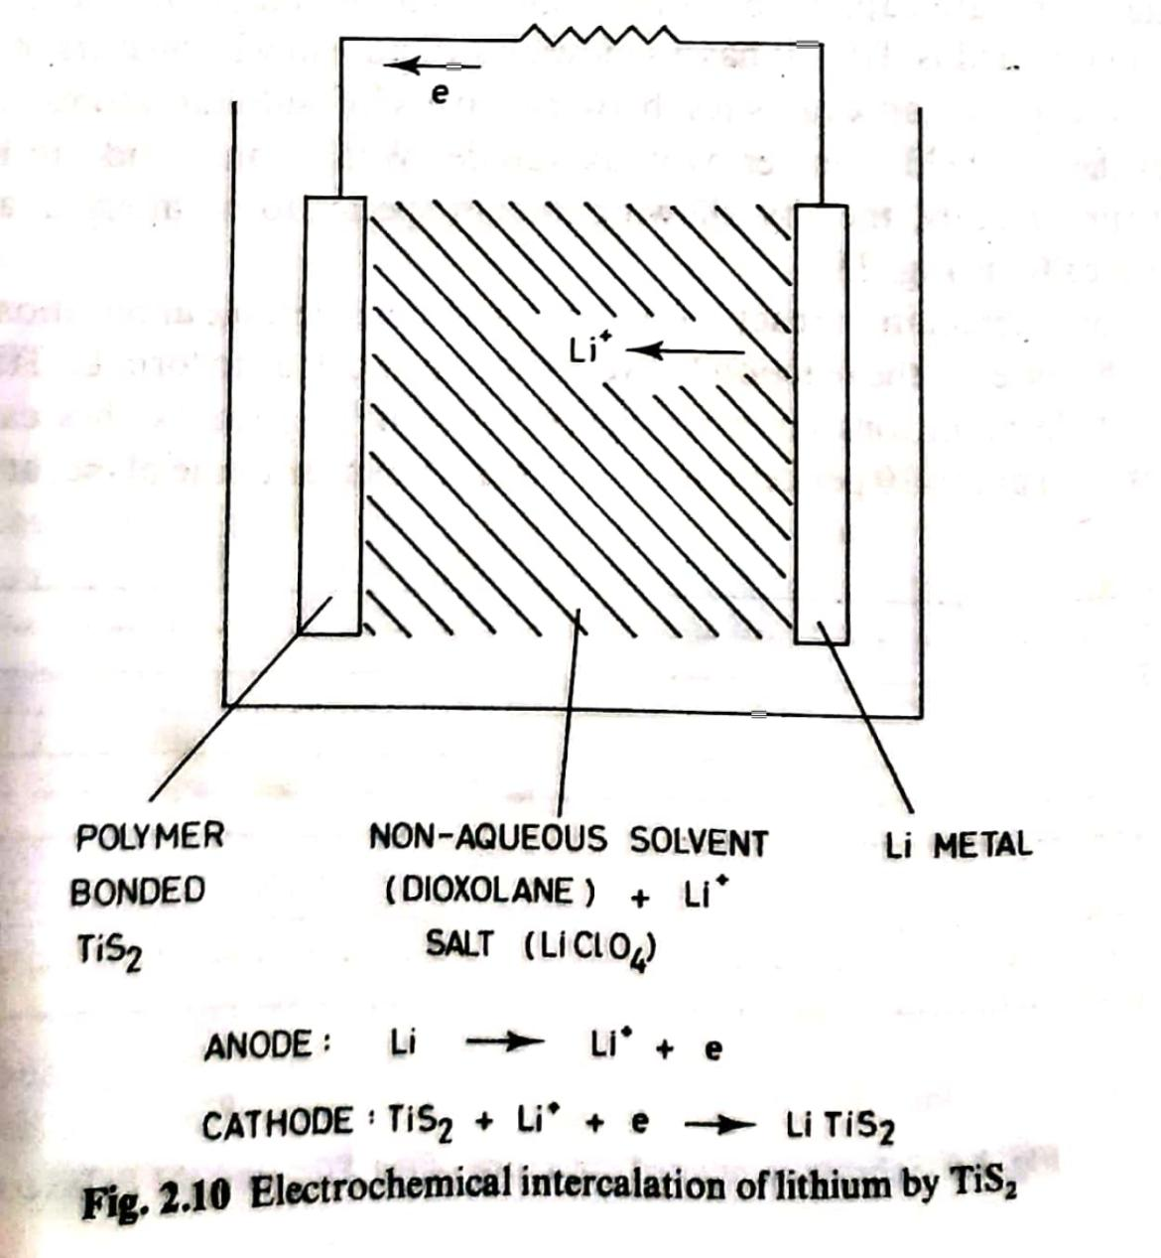
Electrochemical intercalation of lithium by TiS₂

Slide 86
Pillared Clays
Pillaring - formation of 2D space among the layers
Eg;. Montmorillonite (a clay) undergoes ion exchange with the huge inorganic cation [Al₁₃O₄(OH)₂₄(H₂O)₁₂]⁷⁺ by slurring with an basic solution of Al ions
The material is calcined after washing with water.
It loses hydroxyls and water,
Thus alumina pillars get formed among the silicate layers of the clay, resulting into a microporous substance.
Zirconia pillars can be created by calcining with zirconium oxychloride after ion exchange.

Slide 87
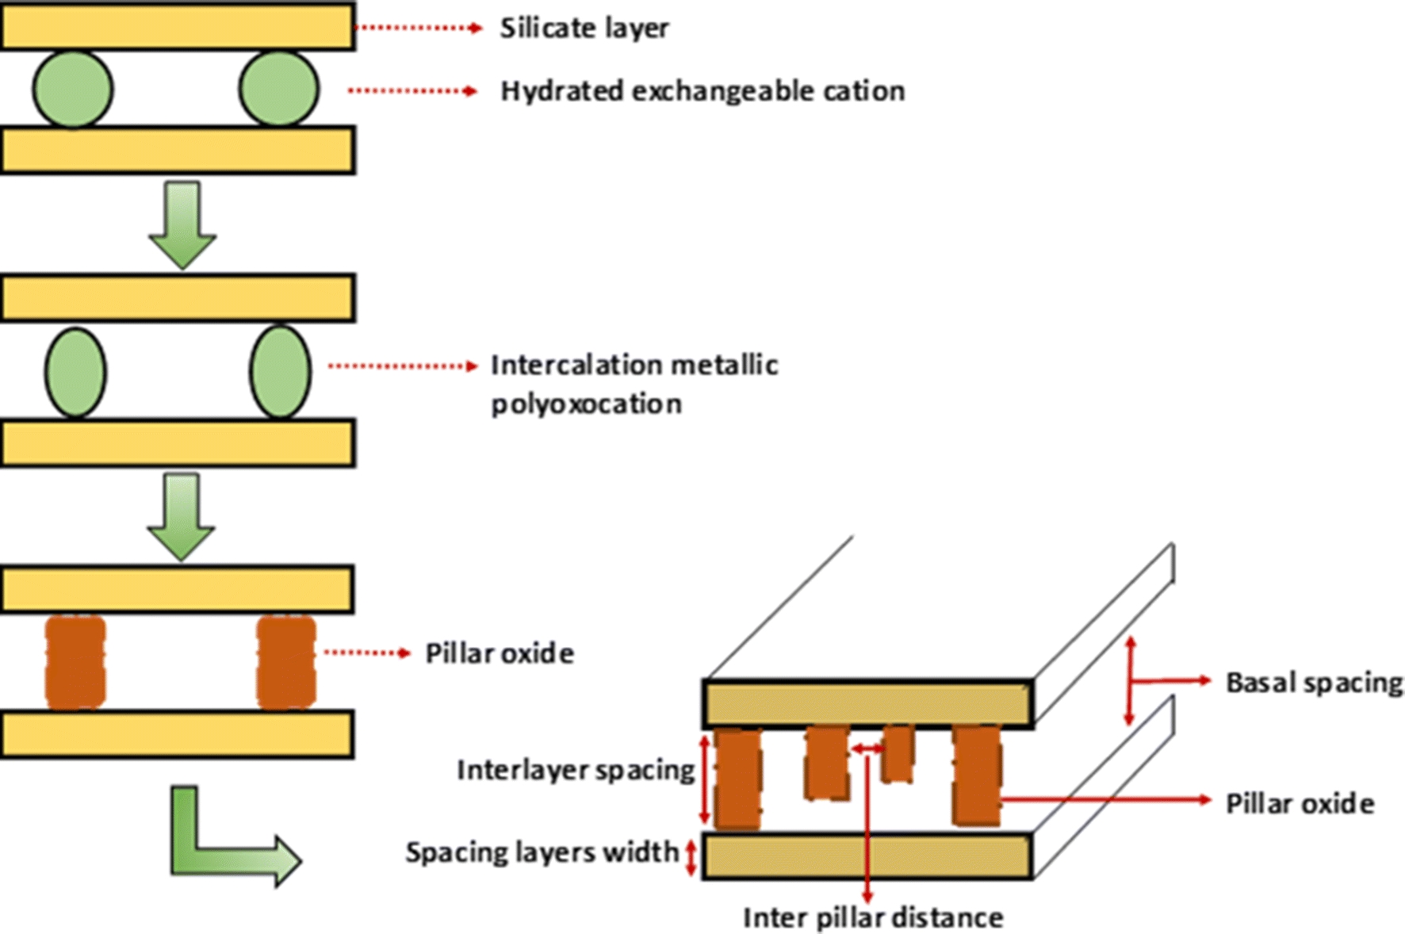

Slide 88
Fullerides:
Sir Harry Kroto discovered fullerene in 1985 at the University of Sussex.
The passage of an electric arc between two carbon rods forms fullerene in an atmosphere of helium.
formula :C60
Symmetrical with every carbon atom identical
20 hexagons of carbon atoms connected to 12 pentagons.
The structure of
buckminster fullerene,
C60.
SOLID STATE CHEMISTRY An Introduction Third ed, 2005

Slide 89
Distance between C-C distance in -
i) Adjacent hexagons - 139 pm,
ii) Hexagon and pentagon- 143 pm
Carbon sheet with graphite-type delocalized bonding.
Use of fullerenes:
Electronic devices,
Targeted cancer therapy

Slide 90
Thank You

